Slide 1
Task Manager with Progress Tracker
CAPSTONE PROJECT
Presented By:
Vinay Rawat
Graphic Era Hill University, Dehradun
CSE

Slide 2
OUTLINE
Problem Statement (Should not include solution)
System Development Approach (Technology Used)
Algorithm & Deployment (Step by Step Procedure)
Result
Conclusion
Future Scope(Optional)
References

Slide 3
Problem Statement
Many individuals struggle to manage their daily tasks effectively.
It is difficult for users to track their progress on tasks consistently.
Traditional methods like paper lists or basic notes are often inflexible and lack visual motivation.
Users face challenges in prioritizing tasks, meeting deadlines, and maintaining productivity.
There is a need for an application that allows users to add, edit, complete, and delete tasks easily.
Visualizing progress can help users stay motivated and improve time management.
A simple and interactive solution can enhance personal productivity and organization.

Slide 4
System Approach
ProTask is a client-side, single-page application (SPA) following a simple MVC pattern:
Model: Task data in a JavaScript array, persisted via LocalStorage.
View: Dynamically renders HTML elements.
Controller: Handles user events for state updates.
Zero server reliance allows instant loading and offline usage.
Key Technologies
HTML5: Semantic UI structure (<header>, <main>, <ul>) for accessibility & SEO.
CSS3: Theming via custom properties, Flexbox layouts, transitions, media queries.
JavaScript (ES6+): DOM handling, event delegation, inline editing, JSON serialization.
LocalStorage API: Persists tasks and theme.
Google Fonts API: Poppins, Playfair Display, Courier New, Orbitron.
GitHub Pages: Hosts the static site; Git for version control.

Slide 5
Algorithm & Deployment
Core Algorithm
Initialization: Load tasks and theme from LocalStorage; render UI.
Add Task: Push to tasks array → save → render.
Render Tasks: Update task list HTML; show placeholder if empty; update progress.
Interaction: Toggle complete, edit, delete tasks → save & render.
Progress Tracking: Calculate % completed → update progress bar/text.
Theme Switch: Apply selected theme → persist.
Deployment Steps
Create GitHub repo, add index.html, style.css, script.js.
Test locally; commit & push.
Enable GitHub Pages; verify online.

Slide 6
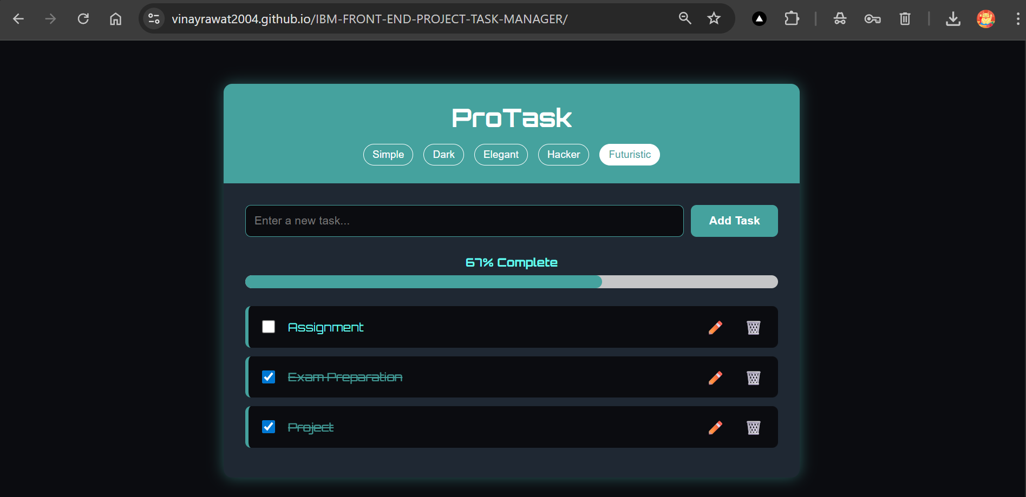
Result

Slide 7
GITHUB AND DEPLOYMNET LINK
Attach your Github Link : https://github.com/VinayRawat2004/IBM-FRONT-END-PROJECT-TASK-MANAGER
Deployment link: https://vinayrawat2004.github.io/IBM-FRONT-END-PROJECT-TASK-MANAGER/

Slide 8
Conclusion
ProTask is a lightweight, fully functional to-do app built with vanilla web technologies.
Implements CRUD operations, real-time progress tracking, theming, and persistence without a backend.
Follows an MVC-like pattern, ensuring maintainability and modularity.
Fully responsive design ensures usability across devices.
Handles 0–100 tasks smoothly with optimized performance.
Deployment via GitHub Pages enables free, seamless hosting.
Demonstrates that simple, small-sized SPAs (<11KB) can provide a rich user experience.

Slide 9
Future scope(Optional)
Cloud Sync: Integrate Firebase for cross-device task access and backup.
Advanced Task Management: Add priorities, deadlines, categories/tags, and reminders.
Search & Filter: Quickly locate tasks via keyword search or filters.
Export/Import: Enable tasks export/import in JSON/CSV format.
Analytics: Visualize productivity trends, daily/weekly completion summaries.
PWA Support: Offline caching, push notifications, installable app features.
User Authentication: Optional login for personalized task lists across devices.
Testing & Maintenance: Unit testing (Jest) for core functions like renderTasks and updateProgress.

Slide 10
References
MDN Web Docs: LocalStorage API - https://developer.mozilla.org/en-US/docs/Web/API/Window/localStorage
CSS-Tricks: CSS Custom Properties - https://css-tricks.com/css-custom-properties-part-1/
GitHub Pages Documentation - https://docs.github.com/en/pages/getting-started-with-github-pages
Google Fonts - https://fonts.google.com/

Slide 11
THANK YOU

